Slide 1
Delaunay Triangulation: From Points to Meshes
-Arun Soma

Slide 2
TABLE OF CONTENTS
01
02
03
04
05
06
Introduction
Triangulation basics
Delaunay
Voronoi duality
Core construction Algos
07
08
09
10
Data structures &cmplexity
implementation
applications
summary
questions

Slide 3
introduction

Slide 4
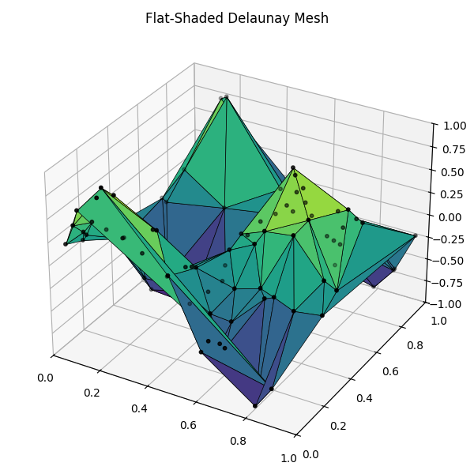
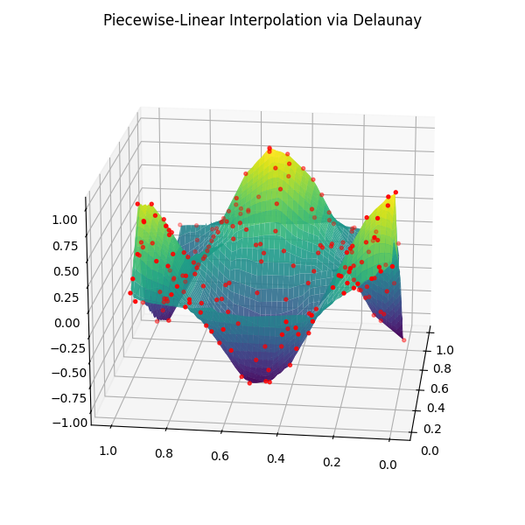
Why Triangulate?
Many algorithms ( rendering , FEM , interpolation ) need a mesh
Good triangles avoid “slivers” and improve numerical stability
Delaunay maximizes minimum angles -> better-shaped triangles

Slide 5
Triangulation basics

Slide 6
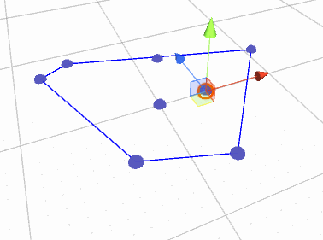
What is a triangulation?
Given a planar point set, a triangulation connects points to form non-overlapping triangles that cover the convex hull
Any two triangles meet only at the shared edge or vertex
Multiple valid triangulations exist for the same points

Slide 7
Why “Naïve” Meshes Can Fail
Skinny/sliver triangles → poor interpolation, slow convergence in FEM
Numerical instability in graphics & simulation
Need a criterion to pick the “best” triangulation

Slide 8
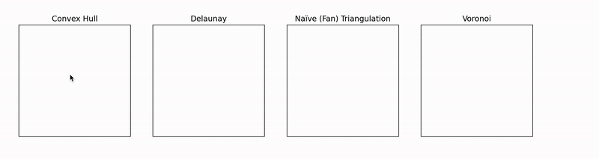
Delaunay triangulation
Empty‐circle property: no point lies inside circumcircle of any triangle
Uniqueness: unique if no four points are cocircular
Max–min angle: maximizes smallest angle across all triangulations

Slide 9
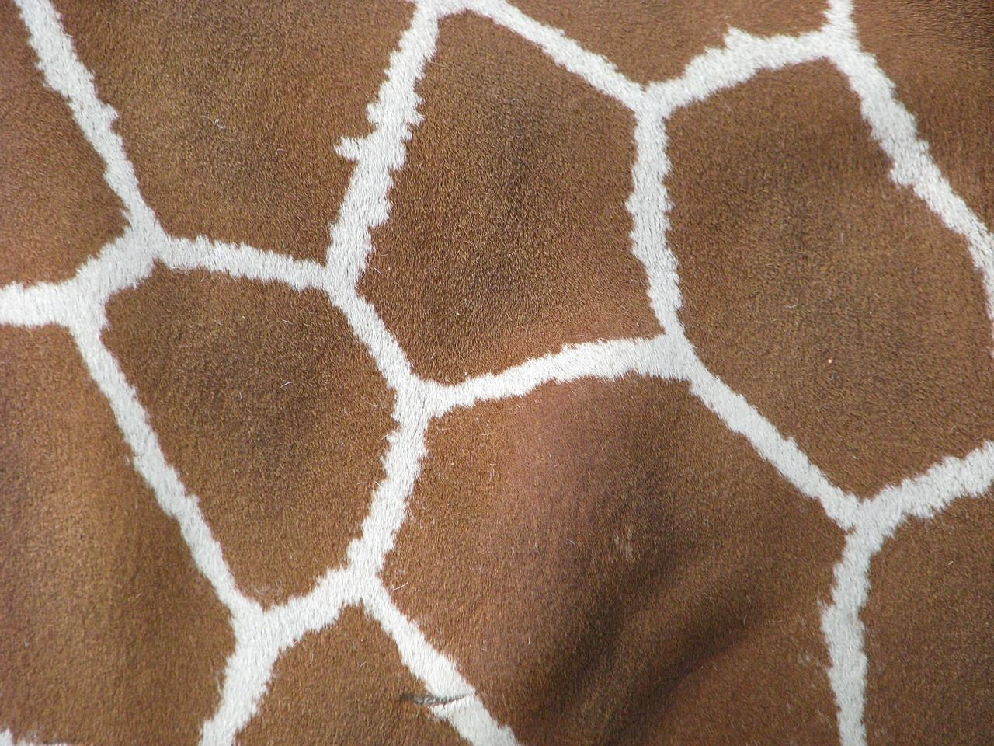
Dual of the Voronoi Diagram
Voronoi: cells of nearest‐neighbor regions
DT edges connect sites whose Voronoi cells share a boundary
Duality helps build one from the other
Giraffe’s Fur

Slide 10
How to Compute DT
Bowyer–Watson (incremental): insert one point at a time, “cavity” re-triangulation
Divide & conquer: split point set, recursively build, then merge
Sweep‐line (Fortune): advance line, maintain beach line structure (2D)
Edge‐flip restoration: start with any triangulation, flip edges to enforce empty‐circle

Slide 11
bowyer-Watson
Initialize with super-triangle
For each new point P:
Mark all bad triangles whose circumcircle contains P
Find boundary edges of that “cavity” (edges appearing only once among bad triangles)
Remove bad triangles
Retriangulate by connecting P to each boundary edge
Notes:
“We start from one huge triangle that contains all points. When we insert a point, we carve out a hole by removing all triangles whose circumcircles enclose it. The hole’s boundary is a ring of edges; we then connect the new point to each consecutive edge to fill the hole with new triangles that preserve Delaunayhood.”

Slide 12
bowyer-Watson-data structures used
Point list – array of (x,y) coordinates
Triangle list – list of (i,j,k) indices into the point array
Circumcircle test – for each triangle, store no cache: recompute on demand
Notes:
“We keep two arrays: a growing list of points, and a list of triangles defined by 3 point-indices. At each insertion we scan triangles, test whether the new point lies inside their circumcircle, and then fix up the ‘cavity.’ No fancy tree or edge-flip history is needed for a teaching demo.”

Slide 13
bowyer-Watson-cavity extraction
Bad triangles = circumcircle(P) test
Boundary edges = those seen exactly once
Complexity ~O(n) per insert in the worst case
Notes:
“We test each triangle’s circumcircle in O(1). Collect all edges of bad triangles, count occurrences, keep only those with count =1. That linear scan is fine for moderate sizes and makes the demo code trivial to follow.”

Slide 14
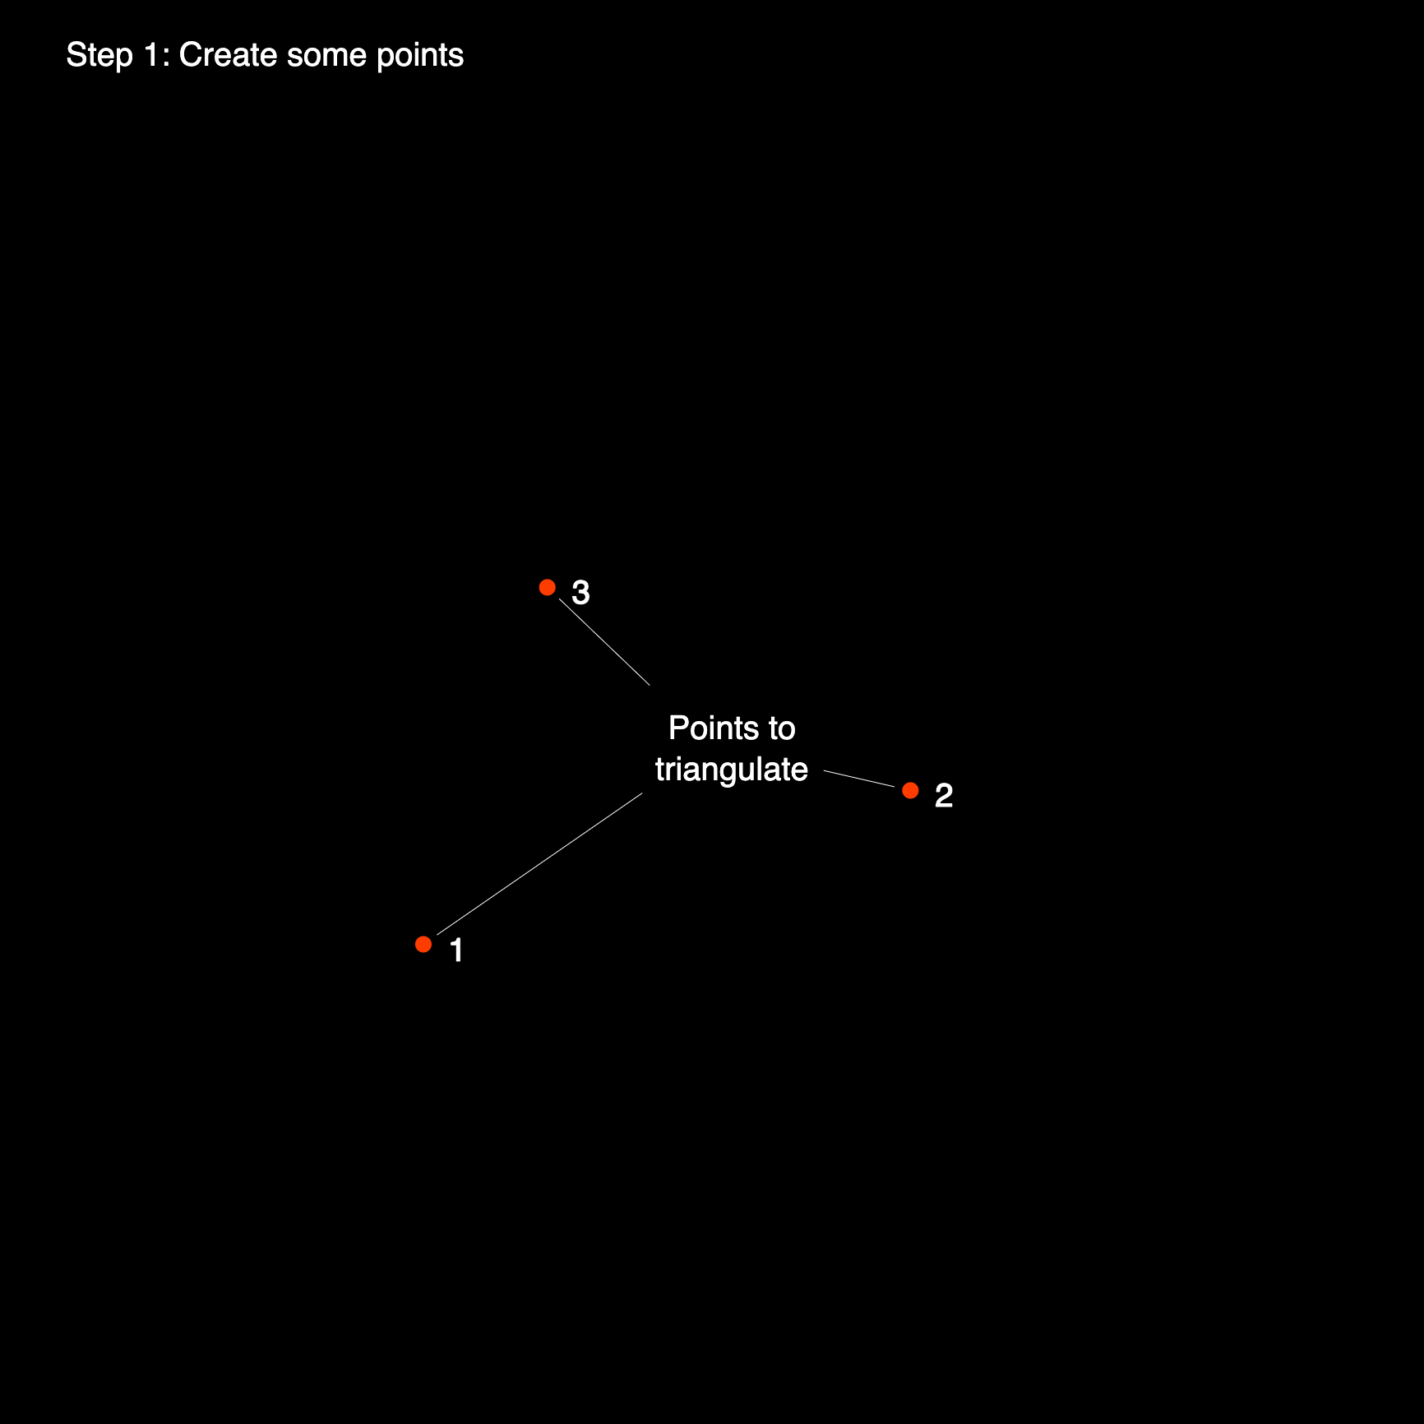
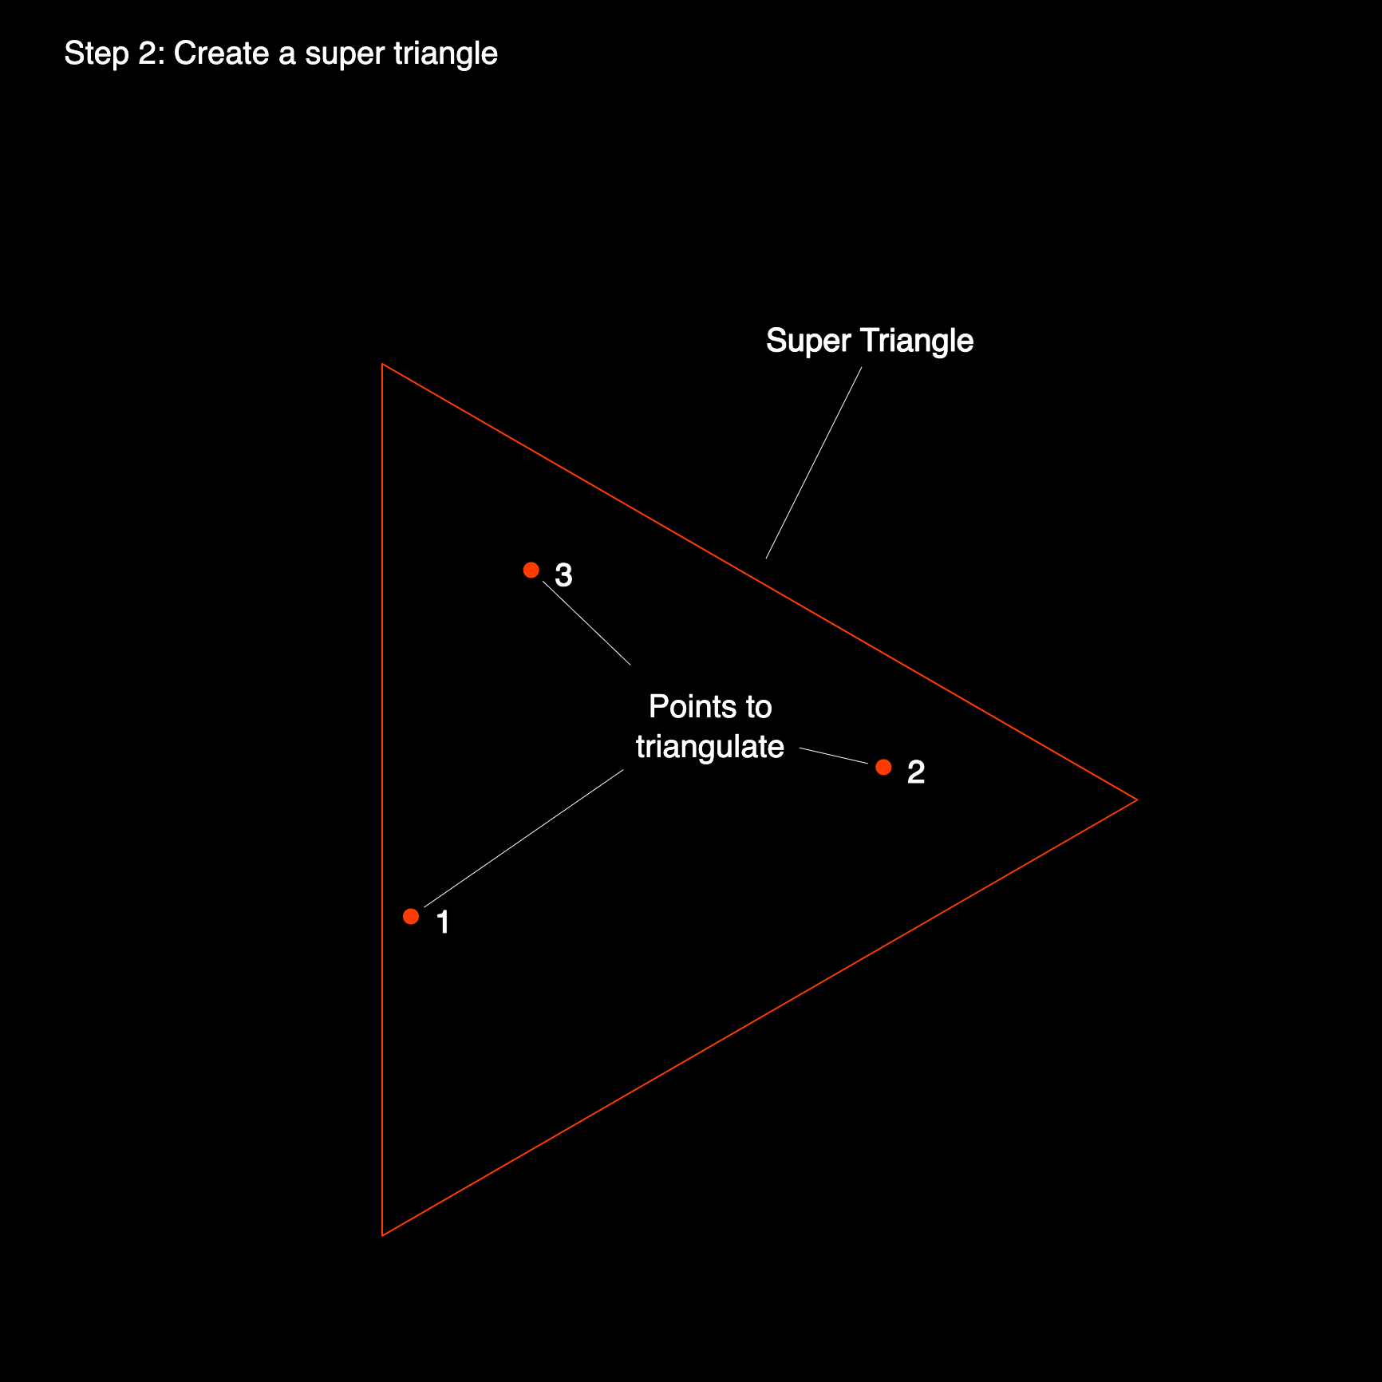
bowyer-Watson-live visualization[1]

Slide 15
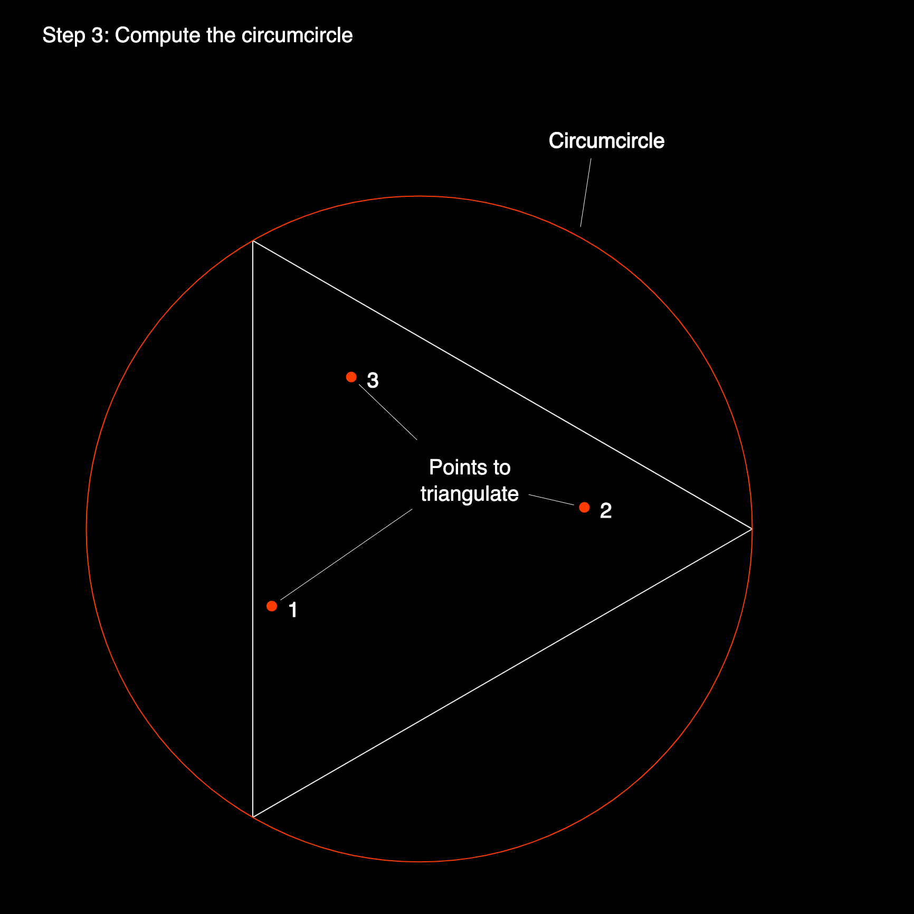
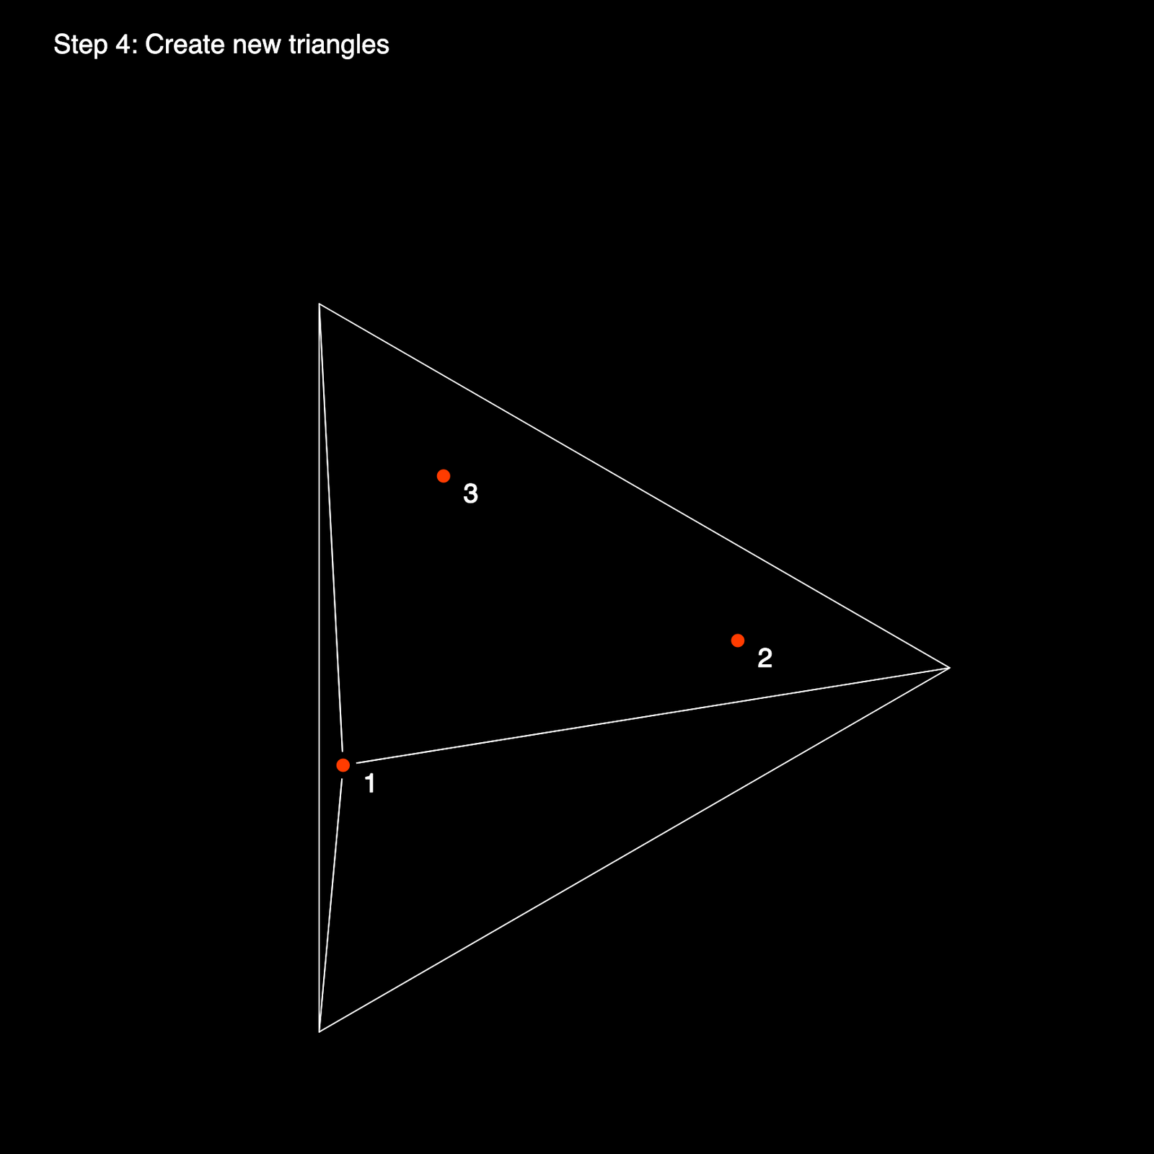

Slide 16
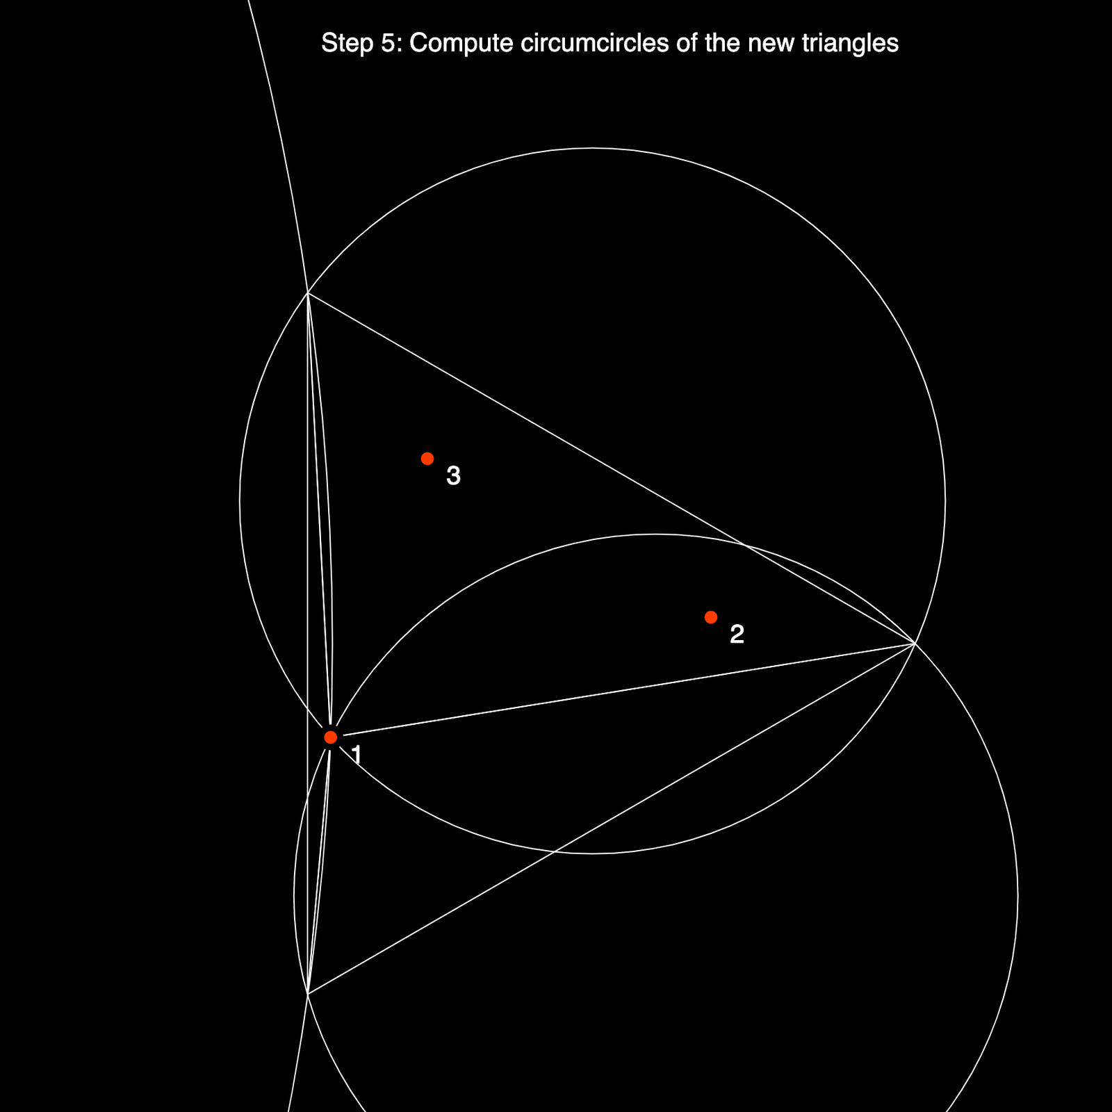
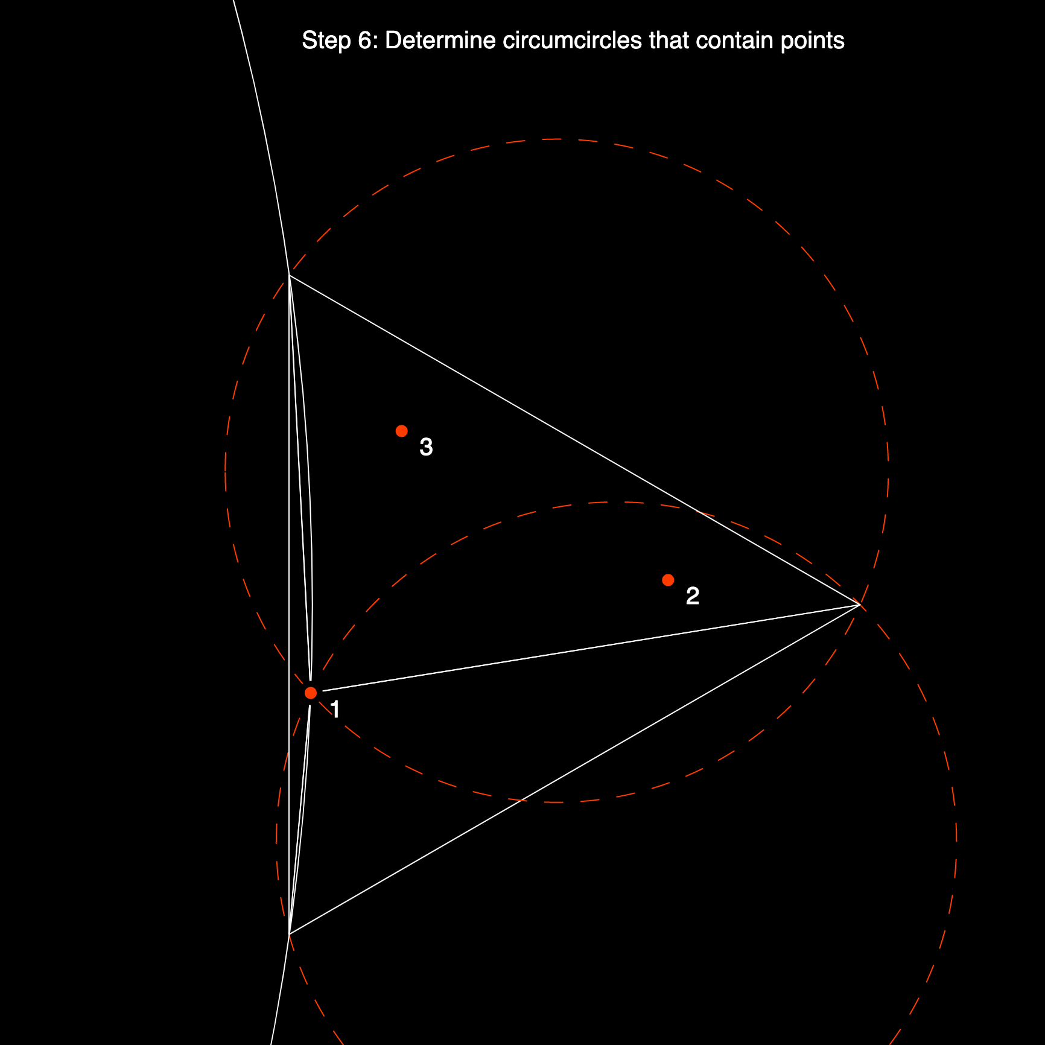

Slide 17
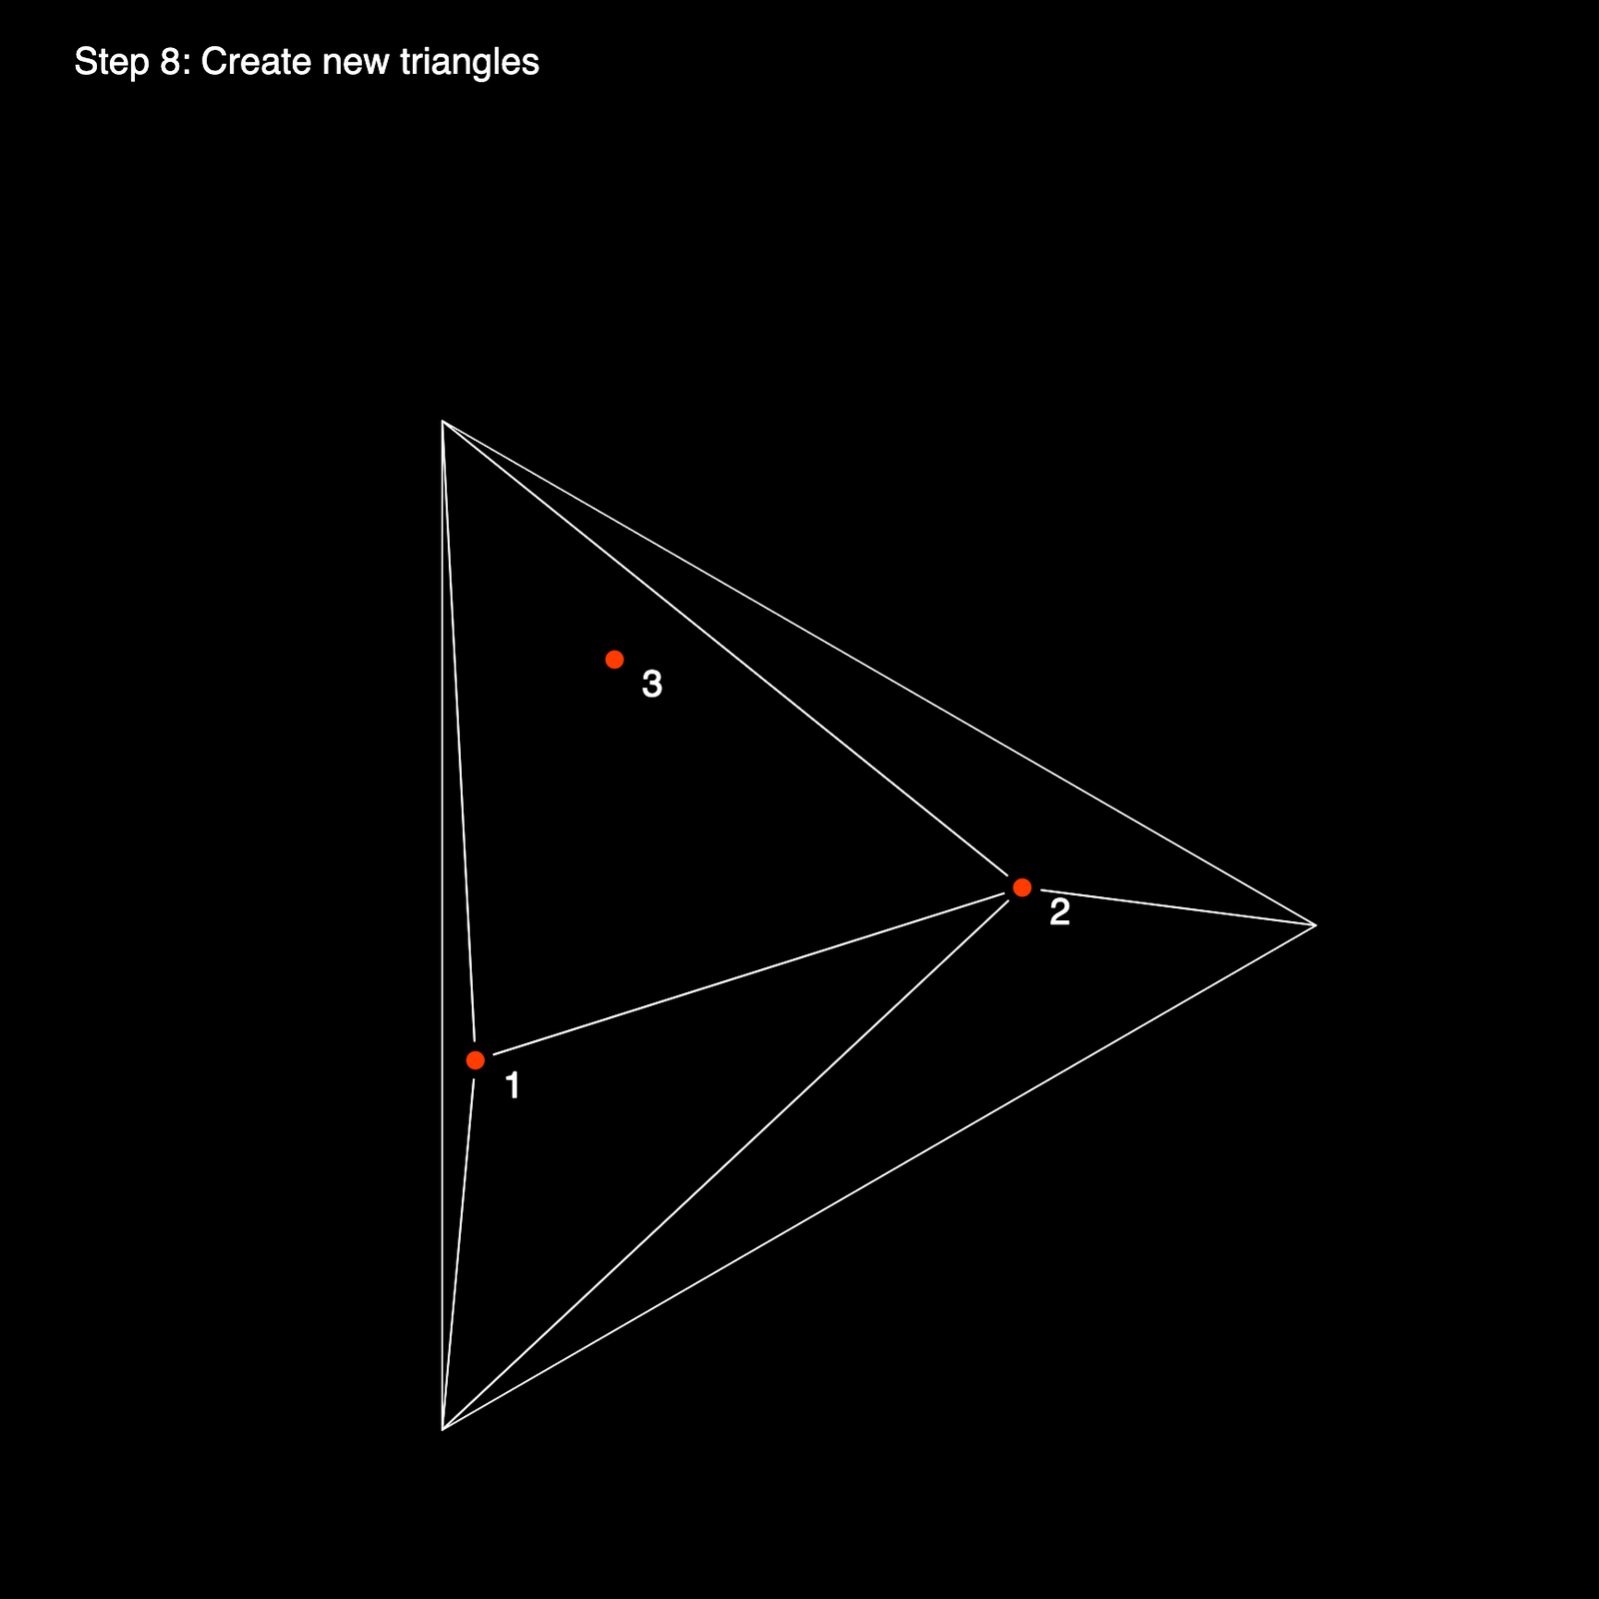
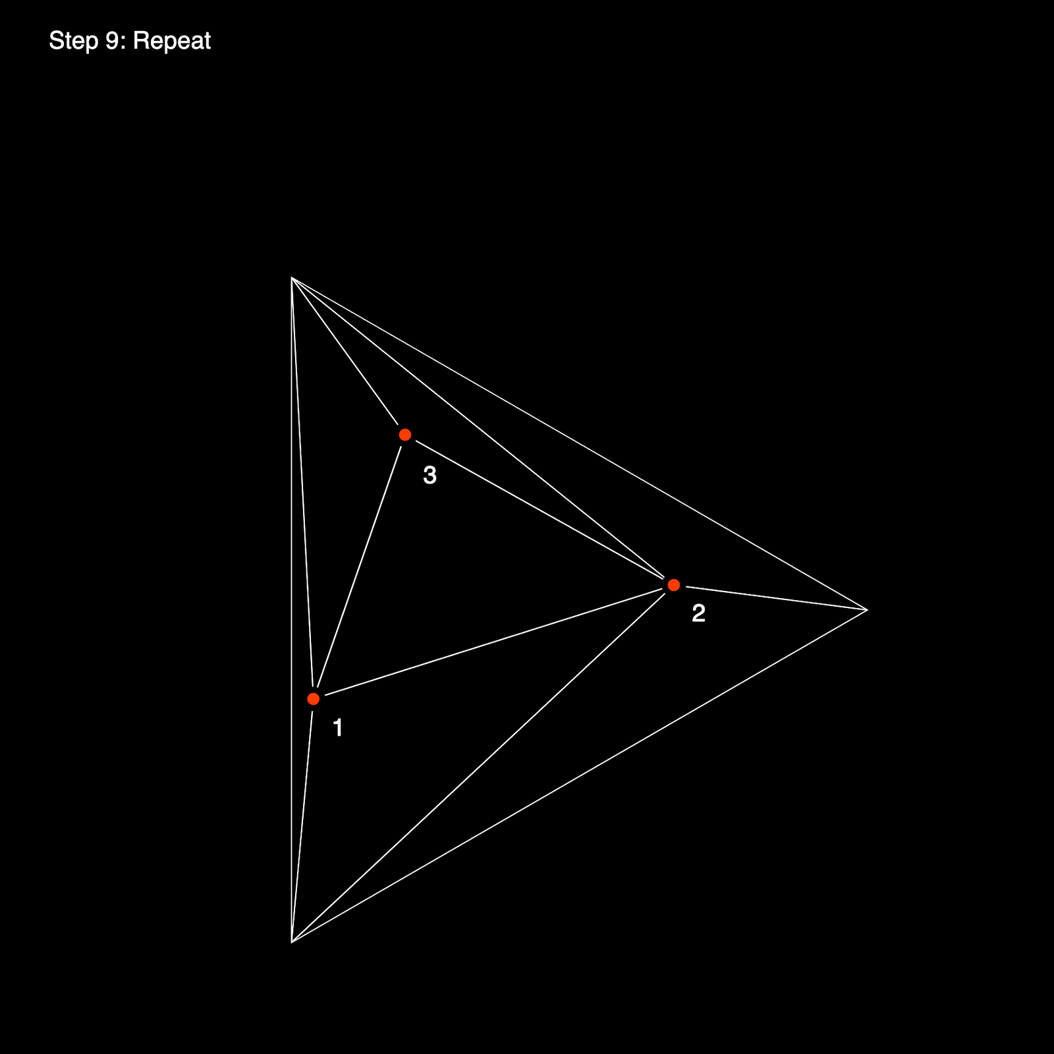

Slide 18
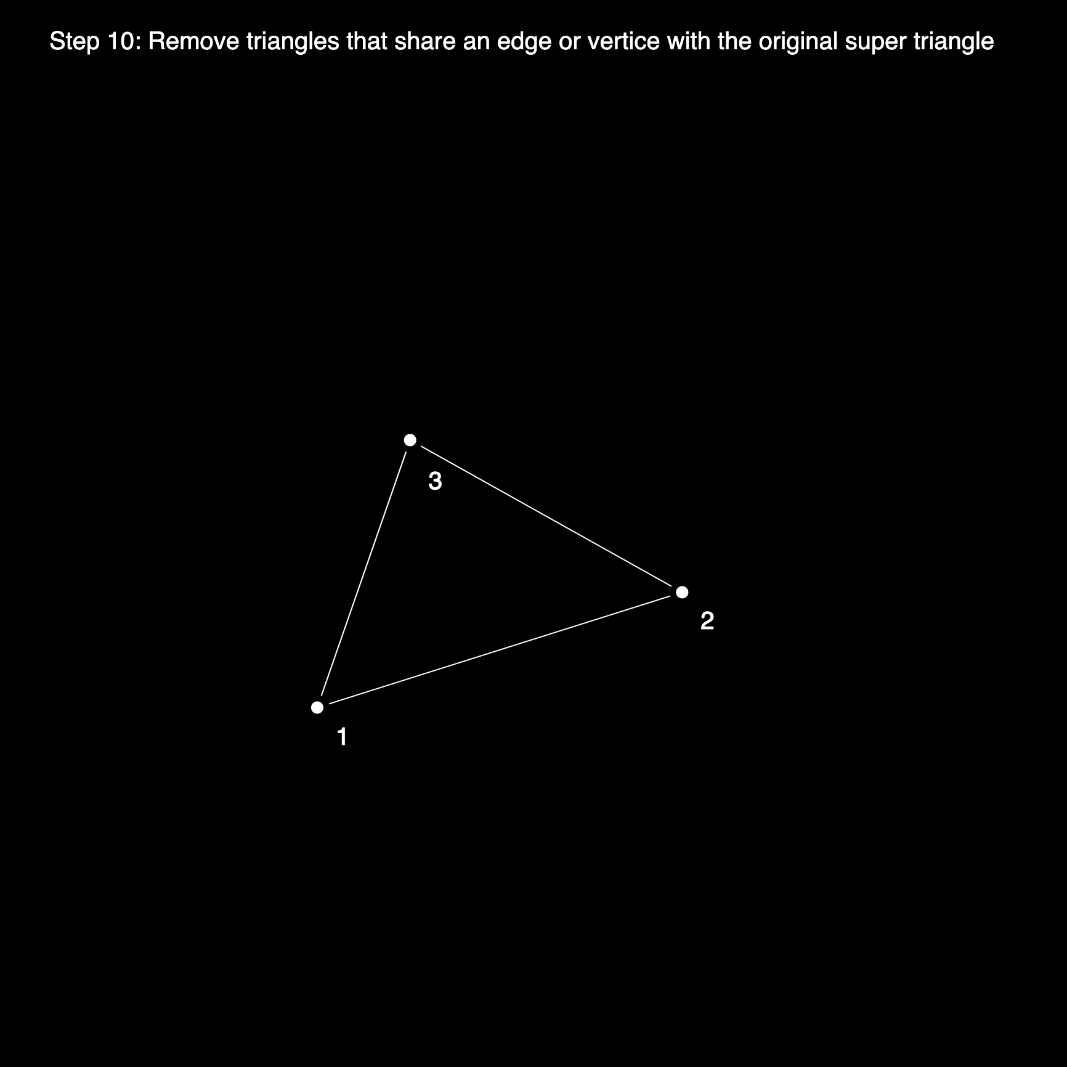
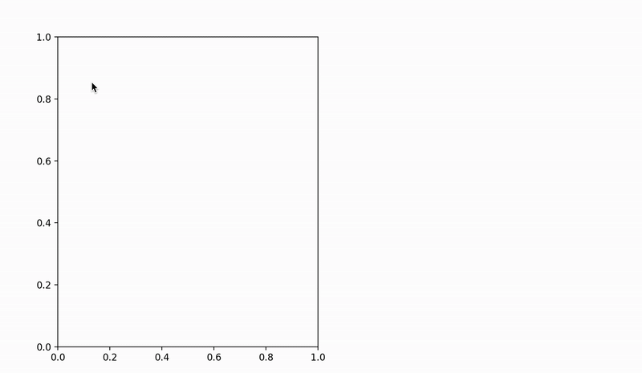

Slide 19
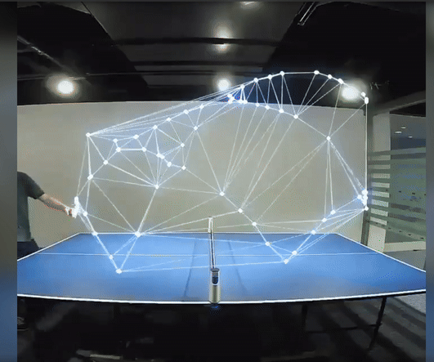
Applications
Mesh generation for finite‐element/finite‐volume methods
Scattered‐data interpolation (natural neighbor, barycentric)
Computer graphics: terrain modeling, remeshing, collision detection
Geospatial & sensor networks: coverage, connectivity

Slide 20
Mcq’s
1. Which of the following is the defining “empty-circle” property of a Delaunay triangulation? A. Every triangle’s circumcircle contains no other input points in its interior. B. Every triangle maximizes the area among all possible triangles. C. Every edge is as short as possible. D. Every point lies on at least one triangle’s circumcircle Answer: A
2. The Delaunay triangulation of a planar point set has which optimality guarantee? A. It minimizes the total number of triangles. B. It maximizes the smallest angle across all triangles. C. It minimizes the sum of squared edge lengths. D. It guarantees all triangles are equilateral Answer: B
3. Which of these is a common algorithm for building a 2D Delaunay triangulation in expected O(n log n) time? A. Graham‐scan insertion B. Bowyer–Watson incremental insertion C. Quickhull planar partition D. Kruskal’s minimum‐spanning‐tree method Answer: B

Slide 21
References
1.https://www.gorillasun.de/blog/bowyer-watson-algorithm-for-delaunay-triangulation/
2.https://www.youtube.com/watch?v=IqdSdbxrTsY&t=90s

Slide 22

Questions?

Slide 23


